Slide 1
Algorithms for Inverse Reinforcement Learning
1
Algorithms for Inverse Reinforcement Learning (cs.berkely.edu)
Group 4

Slide 2
Table of contents
01
02
03
2
Overview of IRL
Foundations of MDP
IRL Scenarios
04
Experiment
Group 4

Slide 3
01
Overview of IRL
3
What is IRL?
Why is IRL needed?
Inputs and Outputs
Group 4

Slide 4

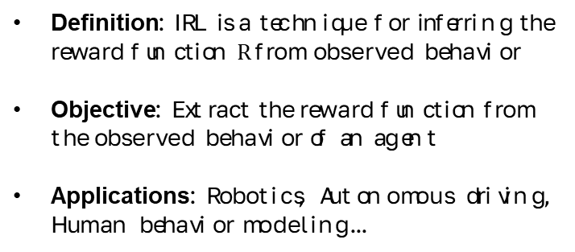
What is IRL?
Overview of IRL
4
Definition: IRL is a technique for inferring the reward function $R$ from observed behavior
Objective: Extract the reward function from the observed behavior of an agent
Applications: Robotics, Autonomous driving, Human behavior modeling...

Slide 5

Why is IRL needed?
Overview of IRL
5
Humans excel at subjective tasks, such as autonomous driving, interpreting emotional states in communication,... For machines to perform these tasks, they need to infer the hidden reward functions that humans use to make decisions. However, these reward functions are often poorly defined, especially in complex scenarios, making traditional reinforcement learning impractical.

Slide 6
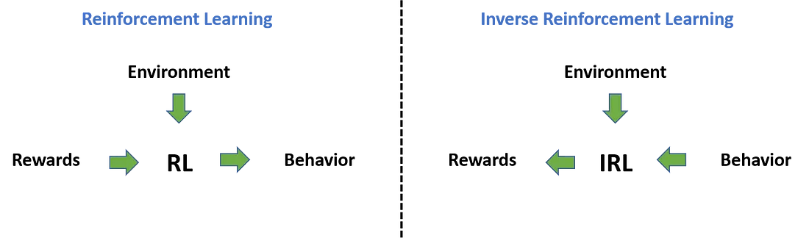
Inputs and Outputs
Overview of IRL
6
Input:
Observed agent behavior.
(Optional) Sensory inputs and environment model.
Output:
The optimized reward function.

Slide 7
02
Foundations of MDP
7
Markov Decision Processes (MDPs)
Bellman Equations
Bellman Optimality
Group 4

Slide 8
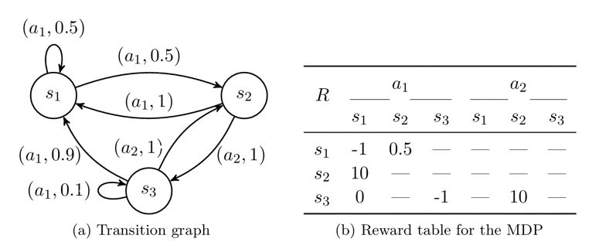
Markov Decision Processes
Foundations of MDP
8
Markov Decision Process (MDP) is a framework for modeling decision-making problems in stochastic environments, where outcomes depend on the current state and the actions taken by the decision-maker. The objective of MDP is to find an optimal policy that maximizes the expected cumulative reward over time.

Slide 9
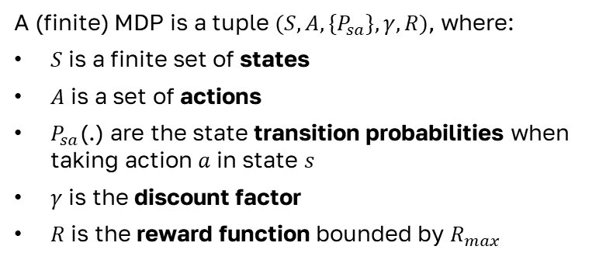
Markov Decision Processes
Foundations of MDP
9
A (finite) MDP is a tuple $(S, A, \{P_{sa}\}, γ, R)$, where:
$S$ is a finite set of states
$A$ is a set of actions
$P_{sa}$(.) are the state transition probabilities when taking action $a$ in state $s$
$γ$ is the discount factor
$R$ is the reward function bounded by $R_{max}$

Slide 10
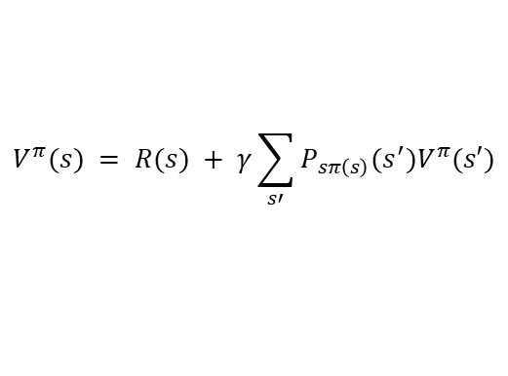
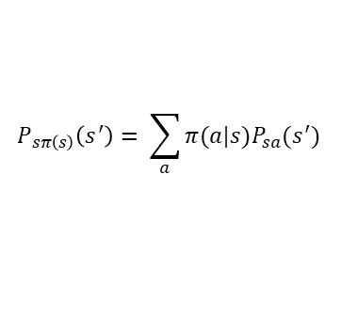
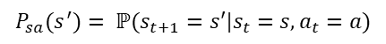
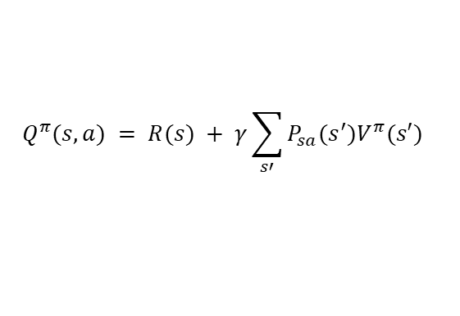
Bellman Equations
Foundations of MDP
10
Let an MDP $M=(S, A, \{P_{sa}\}, γ, R)$ and a policy $π : S → A$be given. Then, for all $s ∈ S, a ∈ A,V^{π}$ and $Q^{π}$ satisfy:
$$V^{π}(s) = R(s) + γ\sum_{s′}{P_{sπ\left(s\right)}(s^{′})V^{π}(s′)}$$
Where:
$$P_{sa}(s^{′})= ℙ(s_{t+1}=s′|s_{t}=s,a_{t}=a)$$
$$Q^{π}(s,a) = R(s) + γ\sum_{s′}{P_{sa}(s^{′})V^{π}(s′)}$$
$$P_{sπ\left(s\right)}\left(s^{′}\right)= \sum_{a}{π(a|s)P_{sa}(s^{′})}$$

Slide 11
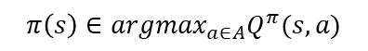
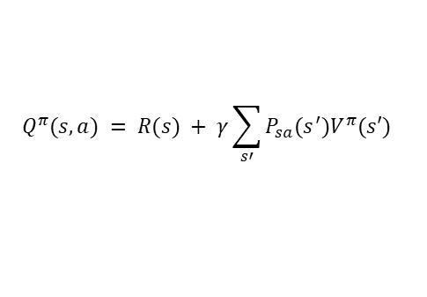
Bellman Optimality
Foundations of MDP
11
Let an MDP $M=(S, A, \{P_{sa}\}, γ, R)$ and a policy $π : S → A$be given. Then $π$ is an optimal policy for $M$ if and only if, for all $s ∈ S$
$$π\left(s\right)∈{argmax}_{a∈A}Q^{π}(s,a)$$
Where:
$$Q^{π}(s,a) = R(s) + γ\sum_{s′}{P_{sa}(s^{′})V^{π}(s′)}$$

Slide 12
03
IRL Scenarios
12
Finite State Spaces
Large State Spaces
Sampled Trajectories
Group 4

Slide 13
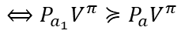
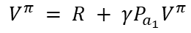
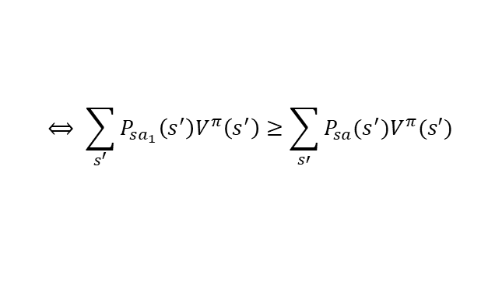
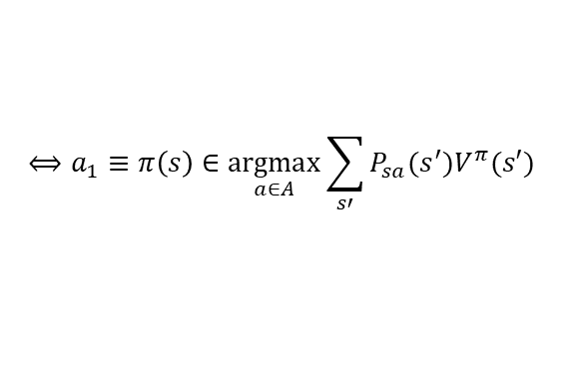
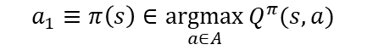

Finite State Spaces
IRL Scenarios
13
Let a finite state space $S$, a set of actions $A=\{a_{1}, …,a_{k}\}$, transition probability matrices {$Pa$}, and a discount factor $γ∈(0,1)$be given. Then the policy π given by $π(s)=a_{1}$ is optimal
$$a_{1}≡π\left(s\right)∈\underset{a∈A}{argmax}{Q^{π}(s,a)}$$
$$⟺a_{1}≡π\left(s\right)∈\underset{a∈A}{argmax}{\sum_{s′}{P_{sa}(s^{′})V^{π}(s′)}}$$
$$V^{π} = R + γP_{a_{1}}V^{π}$$
$$⇔V^{π} ={(I−γP_{a_{1}})}^{−1}R$$
$$⟺ \sum_{s^{′}}{P_{sa_{1}}\left(s^{′}\right)V^{π}\left(s^{′}\right)}≥\sum_{s′}{P_{sa}(s^{′})V^{π}(s′)}$$
$$⟺P_{a_{1}}V^{π}≽P_{a}V^{π}$$

Slide 14
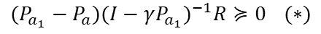
Finite State Spaces
IRL Scenarios
14
Let a finite state space $S$, a set of actions $A=\{a_{1}, …,a_{k}\}$, transition probability matrices {$Pa$}, and a discount factor $γ∈(0,1)$be given. Then the policy π given by $π(s)=a_{1}$ is optimal
$$P_{a_{1}}{(I−γP_{a_{1}})}^{−1}R≽P_{a}{(I−γP_{a_{1}})}^{−1}R$$
$(P_{a_{1}}−P_{a}){(I−γP_{a_{1}})}^{−1}R≽0$ $(∗)$

Slide 15
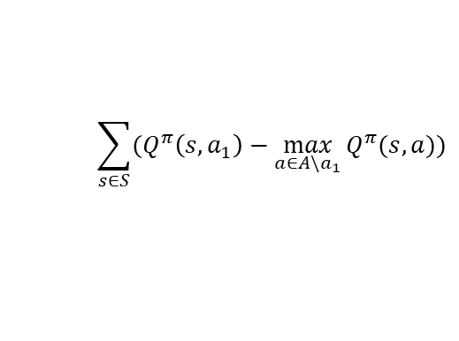
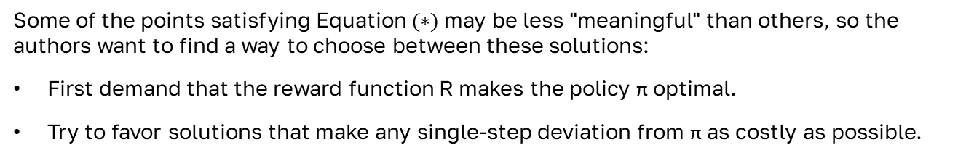
Finite State Spaces
IRL Scenarios
15
Some of the points satisfying Equation $(∗)$ may be less "meaningful" than others, so the authors want to find a way to choose between these solutions:
First demand that the reward function R makes the policy π optimal.
Try to favor solutions that make any single-step deviation from π as costly as possible.
$$\sum_{s∈S}{(Q^{π}\left(s,a_{1}\right)−\max_{a∈A\backslash a_{1}}{Q^{π}(s,a)})}$$

Slide 16
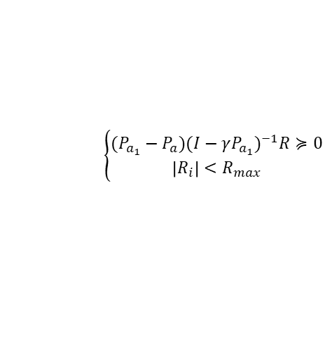
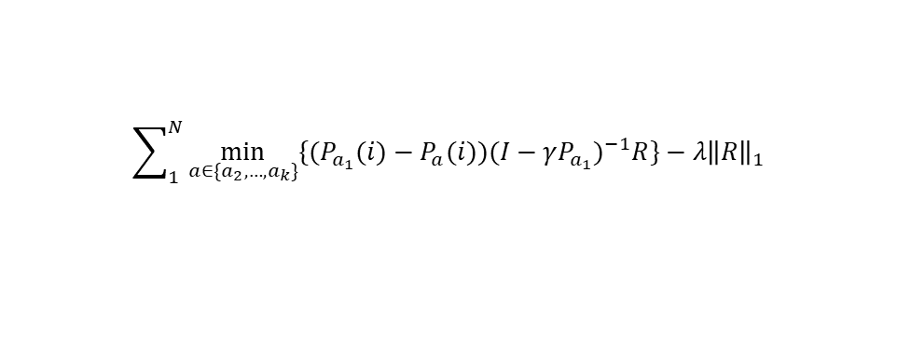
Finite State Spaces
IRL Scenarios
16
Additionally, the authors suggest adding a weight decay-like penalty term to the objective function, to encourage "simpler" reward functions with smaller values.
$$\sum_{1}^{N}{\min_{a∈\{a_{2}, …,a_{k}\}}{\{(P_{a_{1}}(i)−P_{a}(i)){(I−γP_{a_{1}})}^{−1}R\}}}−λ{\left\|R\right\|}_{1}$$
s.t.
$$\left\{\begin{aligned}(P_{a_{1}}−P_{a}){(I−γP_{a_{1}})}^{−1}R≽0 \\ &\left|R_{i}\right|<R_{max}\end{aligned}\right.$$

Slide 17
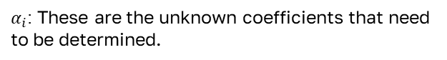
Large State Spaces
IRL Scenarios
17
In infinite state spaces such as $S=ℝ^{n}$, finding the reward function $R$ directly is infeasible because the space of functions mapping $ℝ^{n}→ℝ$ is too large and complex. Therefore, we approximate $R$
$$R\left(s\right)=α_{1}φ_{1}\left(s\right)+α_{2}φ_{2}\left(s\right)+…+α_{d}φ_{d}(s)$$
Where:
$φ_{i}\left(s\right)$: These are known and fixed basis functions.
$α_{i}$: These are the unknown coefficients that need to be determined.

Slide 18
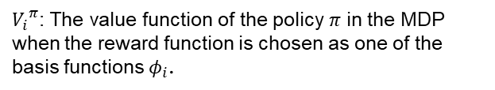
Large State Spaces
IRL Scenarios
18
Since $R$ is a linear combination of basis functions $φ_{i}$, the problem can be solved using linear programming. By the linearity of expectations, the value function $V$ for $R$, a linear combination of $φ_{i}$​, is also linearly expressed.
$$V^{π}=α_{1}{V_{1}}^{π}+α_{2}{V_{2}}^{π}+…+α_{d}{V_{d}}^{π}$$
Where:
$φ_{i}\left(s\right)$: These are known and fixed basis functions.
${V_{i}}^{π}$: The value function of the policy $π$ in the MDP when the reward function is chosen as one of the basis functions $φ_{i}$.

Slide 19
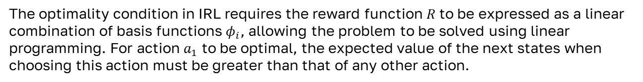
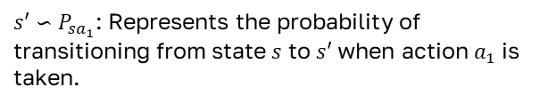
Large State Spaces
IRL Scenarios
19
The optimality condition in IRL requires the reward function $R$ to be expressed as a linear combination of basis functions $φ_{i}$, allowing the problem to be solved using linear programming. For action $a_{1}$ to be optimal, the expected value of the next states when choosing this action must be greater than that of any other action.
$$Ε_{s′∽P_{sa_{1}}}\left[V^{π}\left(s^{′}\right)\right]≥Ε_{s′∽P_{sa}}\left[V^{π}\left(s^{′}\right)\right]$$
Where:
$s′∽P_{sa_{1}}$: Represents the probability of transitioning from state $s$ to $s′$ when action $a_{1}$​ is taken.

Slide 20
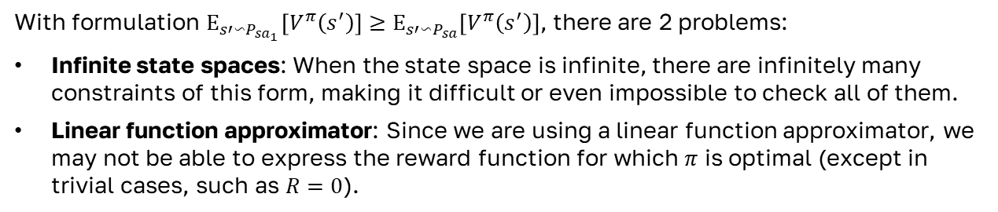
Large State Spaces
IRL Scenarios
20
With formulation $Ε_{s′∽P_{sa_{1}}}\left[V^{π}\left(s^{′}\right)\right]≥Ε_{s′∽P_{sa}}\left[V^{π}\left(s^{′}\right)\right]$, there are 2 problems:
Infinite state spaces: When the state space is infinite, there are infinitely many constraints of this form, making it difficult or even impossible to check all of them.
Linear function approximator: Since we are using a linear function approximator, we may not be able to express the reward function for which $π$ is optimal (except in trivial cases, such as $R=0$).

Slide 21
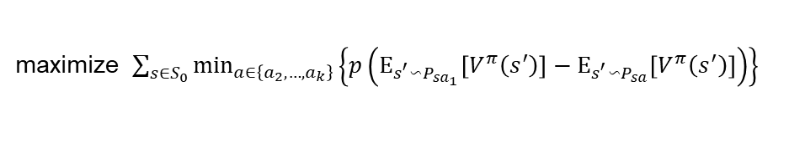
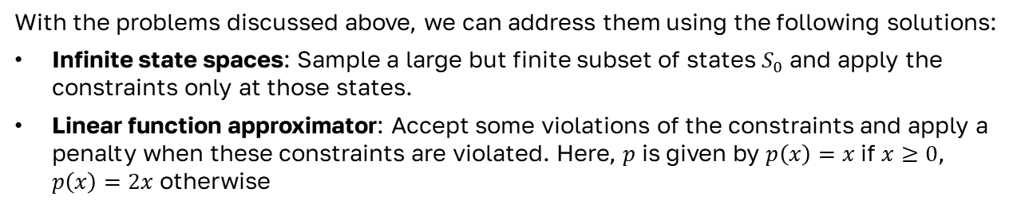
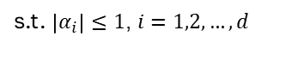
Large State Spaces
IRL Scenarios
21
With the problems discussed above, we can address them using the following solutions:
Infinite state spaces: Sample a large but finite subset of states $S_{0}$ ​and apply the constraints only at those states.
Linear function approximator: Accept some violations of the constraints and apply a penalty when these constraints are violated. Here, $p$ is given by $p\left(x\right)=x$ if $x≥0$, $p\left(x\right)=2x$ otherwise
maximize $\sum_{s∈S_{0}}{\min_{a∈\left\{a_{2},…,a_{k}\right\}}\left\{p\left(Ε_{s^{′}∽P_{sa_{1}}}\left[V^{π}\left(s^{′}\right)\right]−Ε_{s^{′}∽P_{sa}}\left[V^{π}\left(s^{′}\right)\right]\right)\right\}}$
s.t. $\left|α_{i}\right|≤1$, $i=1,2,…,d$

Slide 22
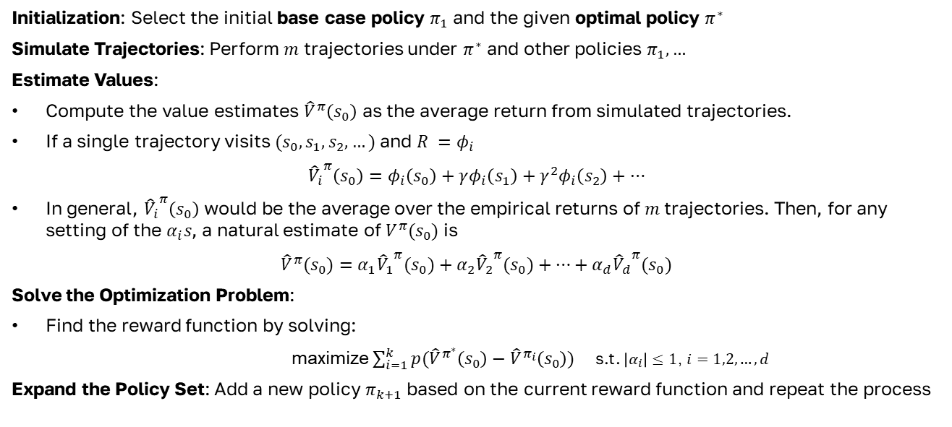
Sampled Trajectories
IRL Scenarios
22
Initialization: Select the initial base case policy ​$π_{1}$ and the given optimal policy $π^{∗}$
Simulate Trajectories: Perform $m$ trajectories under $π^{∗}$ and other policies $π_{1},…$
Estimate Values:
Compute the value estimates ${\hat{V}}^{π}\left(s_{0}\right)$ as the average return from simulated trajectories.
If a single trajectory visits $(s_{0},s_{1},s_{2},…)$ and $R =φ_{i}$
$${{\hat{V}}_{i}}^{π}\left(s_{0}\right)=φ_{i}\left(s_{0}\right)+γφ_{i}\left(s_{1}\right)+γ^{2}φ_{i}\left(s_{2}\right)+…$$
In general, ${{\hat{V}}_{i}}^{π}\left(s_{0}\right)$ would be the average over the empirical returns of $m$ trajectories. Then, for any setting of the $α_{i}s$, a natural estimate of $V^{π}(s_{0})$ is
${\hat{V}}^{π}(s_{0})=α_{1}{{\hat{V}}_{1}}^{π}(s_{0})+α_{2}{{\hat{V}}_{2}}^{π}(s_{0})+…+α_{d}{{\hat{V}}_{d}}^{π}(s_{0})$
Solve the Optimization Problem:
Find the reward function by solving:
maximize $\sum_{i=1}^{k}{p({\hat{V}}^{π^{∗}}\left(s_{0}\right)−{\hat{V}}^{π_{i}}\left(s_{0}\right))}$ s.t. $\left|α_{i}\right|≤1$, $i=1,2,…,d$
Expand the Policy Set: Add a new policy $π_{k+1}$ based on the current reward function and repeat the process

Slide 23
04
Experiment
23
Environment
Utility functions and classes
Mapping between code and pseudocode
Demo
Group 4

Slide 24
Environment
Experiment
24
We will use the MountainCar-v0 environment as an example for the IRL problem (one of the Sampled Trajectories tasks).
Action Space | Discrete(3)
Observation Shape | (2,)
Observation High | [0.6 0.07]
Observation Low | [-1.2 -0.07]
Import | gym.make("MountainCar-v0")

Slide 25
Utility functions and classes
Experiment
25
First, let's go through some main functions and classes.
# The Estimator() class is used to estimate the Q-value function 𝑄(𝑠,𝑎) and update Q-values in the Q-learning algorithm. It utilizes linear regression models (SGDRegressor), with each model corresponding to a specific action.
def featurize_state(self, state):
scaled= self.scaler.transform([state])
featurized= self.featurizer.transform(scaled)
return featurized[0]
def predict(self, s, a=None):
feature_vec= self.featurize_state(s)
if not a:
return np.array([m.predict([feature_vec]) for m in self.models])
else:
return self.models[a].predict([feature_vec])
def update(self, s, a, y):
feature_vec = self.featurize_state(s)
(self.models[a]).partial_fit([feature_vec], [y])
class Estimator():
def __init__(self,env,scaler,featurizer):
self.models=[]
self.env = env
self.scaler = scaler
self.featurizer=featurizer
for _ in range(3):
model=SGDRegressor(learning_rate="constant",
max_iter = 200000000, tol= 1e-10)
model.partial_fit([self.featurize_state(self.env.reset())],[0])
self.models.append(model)

Slide 26
Utility functions and classes
Experiment
26
First, let's go through some main functions and classes.
# Returns a e-greeedy policy
def epsilon_greedy_policy(observation,estimator, epsilon, nA):
A=np.ones(nA, dtype=float) * epsilon / nA
q_values= estimator.predict(observation)
best_action=np.argmax(q_values)
A[best_action] += (1.0 - epsilon)
return A
# Returns a function for generating greedy policy for a state/observation.
def greedy_policy(estimator, nA):
def policy_maker(observation):
A=np.zeros(nA, dtype=float)
q_values= estimator.predict(observation)
best_action=np.argmax(q_values)
A[best_action] += (1.0)
return A
return policy_maker

Slide 27
Utility functions and classes
Experiment
27
# Use the offline version of Q-learning to update the estimator and store learning statistics. It learns Q-values for state-action pairs by using actions selected by a different policy (epsilon-greedy) compared to the policy it is trying to learn (greedy).
def q_learning_best_policy(env, estimator, num_episodes, discount_factor=1.0, epsilon=0.0, epsilon_decay=1.0):
stats= plotting.EpisodeStats(episode_lengths= np.zeros(num_episodes), episode_rewards = np.zeros(num_episodes))
for i in tqdm(range(num_episodes)):
state =env.reset()
done= False
d=0
while not done:
prob = epsilon_greedy_policy(state ,estimator, epsilon * epsilon_decay**i ,env.action_space.n)
action = np.random.choice(np.arange(len(prob)), p=prob )
next_state, reward, done, _ = env.step(action)
stats.episode_rewards[i] += reward
stats.episode_lengths[i] += 1
q_values_next = estimator.predict(next_state)
td_target = reward + discount_factor * np.max(q_values_next)
estimator.update(state,action,td_target)
state=next_state
d+=1
return stats

Slide 28
Utility functions and classes
Experiment
28
First, let's go through some main functions and classes.
# Use the q_learning_best_policy function to perform Q-learning and find the optimal policy. Then, this function creates a greedy policy and returns both this policy along with the Q-value estimator.
def policy_f(env, scaler,featurizer,print_ep_lens):
estimator= Estimator(env,scaler,featurizer)
stats = q_learning_best_policy(env, estimator, 200, epsilon = 0.0, print_ep_lens=False)
print("___Plotting Learning Stats of the Agent____")
plotting.plot_episode_stats(stats, smoothing_window=25)
final_policy = greedy_policy(estimator, env.action_space.n)
return final_policy, estimator

Slide 29
Utility functions and classes
Experiment
29
# Calculates the value and value vector of the start state: V(s₀) (equivalent to the step simulate trajectories and estimate values in the pseudocode).
def ValueFunctionGenerator(env,alpha_vec, policy,featurizer_vec, scaler,featureVecDim, num_trajectories,discount_factor):
v_basis= np.zeros(featureVecDim)
episode = defaultdict(list)
for i in range(num_trajectories):
state= env.reset()
done =False
for l in range(200):
prob = policy(state)
action = np.random.choice(np.arange(len(prob)),p=prob)
new_observations = env.steap(action)
next_state = new_observations[0]
done = new_observations[2]
if done == True:
break
episode[i].append((state,action))
state = next_state
l+=1
env.close()
j=0
for state, action in episode[i]:
v_basis += featurizer_vec.transform([[scaler_val(state,scaler)]])[0]* (discount_factor)**j
j+=1
v_basis_net = v_basis/num_trajectories
V= np.dot(alpha_vec,v_basis_net)
return V , v_basis_net

Slide 30
Utility functions and classes
Experiment
30
Declare global variables and prepare observation examples to determine policy_dbe (Expert policy).
# The variable featureVecDim represents the dimension of the feature vector (equivalent to 𝜙 in the approximation formula for reward 𝑅).
featureVecDim = 50
# Creating an observation set of the state values and then normalizing them using StandardScaler().
$$R\left(s\right)=α_{1}φ_{1}\left(s\right)+α_{2}φ_{2}\left(s\right)+…+α_{d}φ_{d}(s)$$
observation_examples= np.array([env.observation_space.sample() for x in range(10000)]) scaler = normalization(env, observation_examples)
normalized_data = scaler.fit_transform(observation_examples)

Slide 31
Utility functions and classes
Experiment
31
Declare global variables and prepare observation examples to determine policy_dbe (Expert policy).
featureVecDim = 50
# Creating an observation set of the state values and then normalizing them using StandardScaler().
observation_examples= np.array([env.observation_space.sample() for x in range(10000)]) scaler = normalization(env, observation_examples)
normalized_data = scaler.fit_transform(observation_examples)
# Extract features (using RBFSampler) from the scaled data and simultaneously generate a random alpha vector (which represents the weights of the reward function to be learned).
featurizer_vector = featurizer_function(normalized_data, featureVecDim) alpha_vec = RandomVectorGenerator(featureVecDim)
featurizer = state_featurizer(normalized_data)

Slide 32
Utility functions and classes
Experiment
32
Declare global variables and prepare observation examples to determine policy_dbe (Expert policy).
featureVecDim = 50
observation_examples= np.array([env.observation_space.sample() for x in range(10000)]) scaler = normalization(env, observation_examples)
normalized_data = scaler.fit_transform(observation_examples)
# Extract features (using RBFSampler) from the scaled data and simultaneously generate a random alpha vector (which represents the weights of the reward function to be learned).
featurizer_vector = featurizer_function(normalized_data, featureVecDim) alpha_vec = RandomVectorGenerator(featureVecDim)
featurizer = state_featurizer(normalized_data)
# Find the expert policy from the scaled observation set.
policy_dbe, estimator_dbe = policy_f(env,scaler,featurizer,print_ep_lens=False)

Slide 33
Utility functions and classes
Experiment
33
Declare global variables and prepare observation examples to determine policy_dbe (Expert policy).
featureVecDim = 50
observation_examples= np.array([env.observation_space.sample() for x in range(10000)]) scaler = normalization(env, observation_examples)
normalized_data = scaler.fit_transform(observation_examples)
featurizer_vector = featurizer_function(normalized_data, featureVecDim) alpha_vec = RandomVectorGenerator(featureVecDim)
featurizer = state_featurizer(normalized_data)
# Find the expert policy from the scaled observation set.
policy_dbe, estimator_dbe = policy_f(env,scaler,featurizer,print_ep_lens=False)
# IRL Main Code and it will be shown in next slide
reward_fn, alpha_vec = irl(env, alpha_vec, featurizer_vector,scaler,featurizer,
normalized_data,featureVecDim, policy_dbe)
# Extract features (using RBFSampler) from the scaled data and simultaneously generate a random alpha vector (which represents the weights of the reward function to be learned).

Slide 34
Mapping between code and pseudocode
Experiment
34
Initialization: Select the initial base case policy ​$π_{1}$ and the given optimal policy $π^{∗}$
# The expert policy, explained in slide 32, will be provided as a parameter to the IRL function.
policy_dbe, estimator_dbe = policy_f(env,scaler,featurizer,print_ep_lens=False)
# The first iteration of the loop generates a random policy (𝜋₁) using the UniformRandomPolicyGenerator() function.
if nP ==0:
policy_ = UniformRandomPolicyGenerator(env.action_space.n)

Slide 35
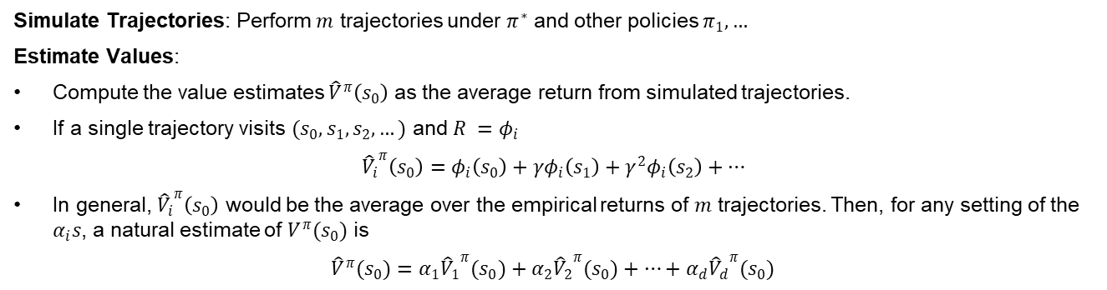
Mapping between code and pseudocode
Experiment
35
Simulate Trajectories: Perform $m$ trajectories under $π^{∗}$ and other policies $π_{1},…$
Estimate Values:
Compute the value estimates ${\hat{V}}^{π}\left(s_{0}\right)$ as the average return from simulated trajectories.
If a single trajectory visits $(s_{0},s_{1},s_{2},…)$ and $R =φ_{i}$
$${{\hat{V}}_{i}}^{π}\left(s_{0}\right)=φ_{i}\left(s_{0}\right)+γφ_{i}\left(s_{1}\right)+γ^{2}φ_{i}\left(s_{2}\right)+…$$
In general, ${{\hat{V}}_{i}}^{π}\left(s_{0}\right)$ would be the average over the empirical returns of $m$ trajectories. Then, for any setting of the $α_{i}s$, a natural estimate of $V^{π}(s_{0})$ is
${\hat{V}}^{π}(s_{0})=α_{1}{{\hat{V}}_{1}}^{π}(s_{0})+α_{2}{{\hat{V}}_{2}}^{π}(s_{0})+…+α_{d}{{\hat{V}}_{d}}^{π}(s_{0})$
# Execute simluate trajectories and estimate values (only one time before into the iterating part, in the other iterations, V_dbe only needs to be updated by multiplying with the new alpha_vec since V_dbe_basis remains unchanged).
V_dbe, V_dbe_basis = ValueFunctionGenerator(env,alpha_vec, policy_dbe, featurizer_vector, scaler,featureVecDim, num_trajectories, discount_factor)
# Execute simluate trajectories and estimate values under other policies.
V_vec[nP], V_policy_basis[nP] = ValueFunctionGenerator(env,alpha_vec,policy_, featurizer_vector,scaler,featureVecDim, num_trajectories, discount_factor)

Slide 36
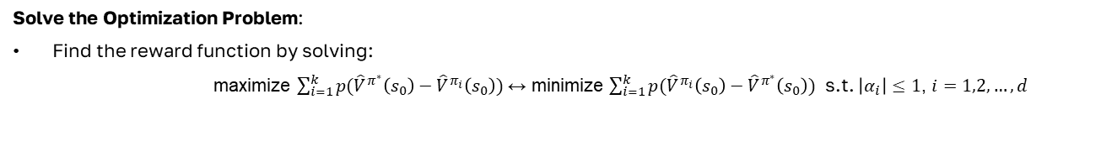
Mapping between code and pseudocode
Experiment
36
Solve the Optimization Problem:
Find the reward function by solving:
maximize $\sum_{i=1}^{k}{p({\hat{V}}^{π^{∗}}\left(s_{0}\right)−{\hat{V}}^{π_{i}}\left(s_{0}\right))}$ ↔ minimize $\sum_{i=1}^{k}{p({\hat{V}}^{π_{i}}\left(s_{0}\right)−{\hat{V}}^{π^{∗}}\left(s_{0}\right))}$ s.t. $\left|α_{i}\right|≤1$, $i=1,2,…,d$
V_input = np.zeros(featureVecDim)
while True:
…
if V_dbe - V_vec[nP] >= 0:
V_input += V_policy_basis[nP] - V_dbe_basis
else:
V_input += penalty_factor* (V_policy_basis[nP] - V_dbe_basis)
# Solve the Linear Programming Optimization Problem that have the objective function and constraints like above
res = scipy.optimize.linprog(V_input, bounds=(-1,1), method="simplex")
alpha_vec_new = res.x
alpha_vec = alpha_vec_new
V_dbe = V_dbe_new
for i,list_ in V_policy_basis.items():
V_vec[i] = np.dot(list_,alpha_vec)
reward_fn = reward(alpha_vec,featurizer_vector,scaler)
…

Slide 37
Mapping between code and pseudocode
Experiment
37
Expand the Policy Set: Add a new policy $π_{k+1}$ based on the current reward function and repeat the process
while True:
…
nP +=1
estimator = Estimator(env,scaler,featurizer)
policy_ = e_greedy_policy(estimator, env.action_space.n,epsilon_v)
if nP > max_epoch:
break
…

Slide 38
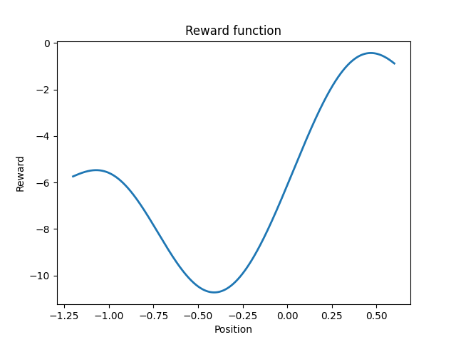
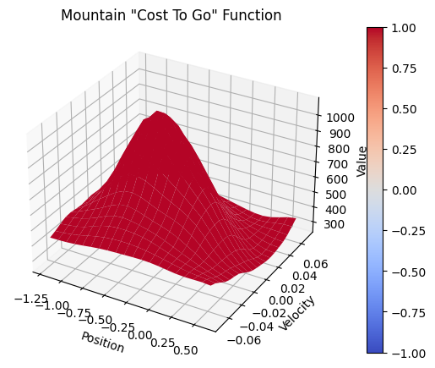
Demo
Experiment
38
Reward function estimated after 10 iterations

Slide 39

Demo
Experiment
39
Simulation of the optimal trajectory following the policy derived from the reward function estimated after 10 iterations

